Slide 1
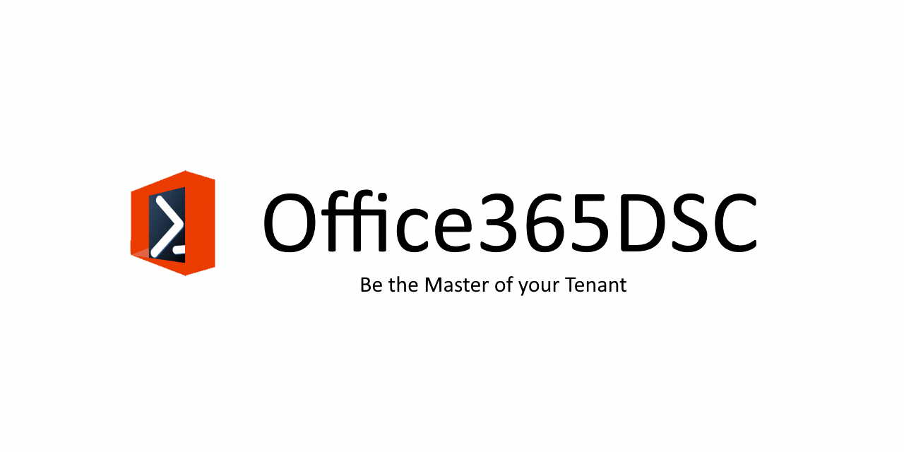


Configuration Change Management for Office 365 using DevOPS
Nik Charlebois – DevOPS Dude
@NikCharlebois

Slide 2

‏@NikCharlebois
Role:
a/Technical Delivery Manager (TDM)
Focus on DevOPS and Automation
About Me:
Ex-PowerShell MVP
Author of multiple SharePoint/O365 books
Based out of Quebec
Speaker at various technology conference
Blogger at http://NikCharlebois.com
Owner of ReverseDSC & Office365DSC
@NikCharlebois

Slide 3
Managing Expectations
It is a technical session – Level 300 +
We’ll take about 10 minutes to do an introduction to DSC;
Get concrete examples you can apply today in your projects;
Please ask your questions as we go;
@NikCharlebois

Slide 4
Agenda
Overview of PowerShell Desired State Configuration;
Introduction to Office365DSC;
ReverseDSC in action;
Azure DevOPS & Integration scenarios for Office 365;
Roadmap;
@NikCharlebois

Slide 5
Famous Last Words
“DevOPS, while it may appear to be just a buzzword to some, is a set of proven best practices taken from both the Dev and the OPS worlds which aims at improving overall IT services delivery. Its core artifact is Code. In DevOPS, everything is managed as Code. Modern IT Pros are now writing as much, if not more Code than traditional Devs in the Enterprise. Be it Documentation-as-Code, Infrastructure-as-Code, Configuration-as-Code, Pipeline Code or plain simply Application Code. You need to embrace that reality if you want to stay relevant.”
- Nik Charlebois

Slide 6
Desired State Configuration
@NikCharlebois

Slide 7

PowerShell DSC (10,000 feet overview)
Deployment Automation and monitoring solution;
Ensures that environments get to & stay in their Desired State;
PowerShell 4.0+ (therefore no support for SP2010);
@NikCharlebois

Slide 8
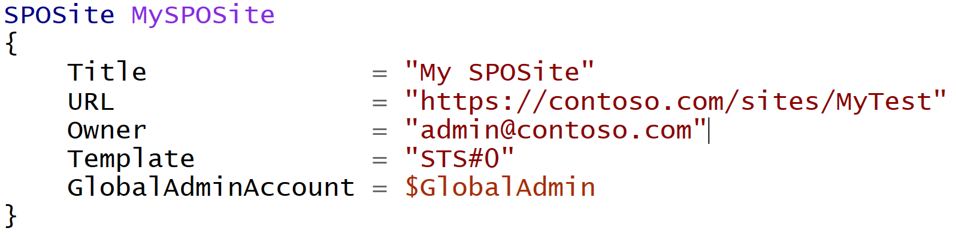
Difference with Classic PowerShell
It’s a Declarative approach;
@NikCharlebois
Notes:
Meaning I don’t tell it do this and then that, but rather here is how I want this, then do whatever in you need to to get me there

Slide 9
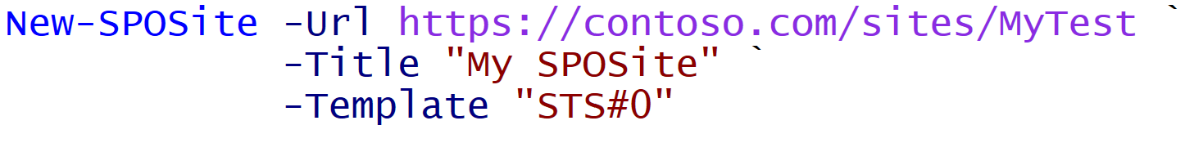
Difference with Classic PowerShell
Declarative:
Imperative:
@NikCharlebois
Notes:
Meaning I don’t tell it do this and then that, but rather here is how I want this, then do whatever you need to get me there

Slide 10
Monitor Configuration Drifts
+Fix
+Monitor
Default Setting
ApplyOnly
ApplyAndMonitor
ApplyAndAutocorrect
Configure as specified, the done
Configure, and Log Configuration Drifts
Configure, Log & Fix Configuration Drifts
@NikCharlebois

Slide 11
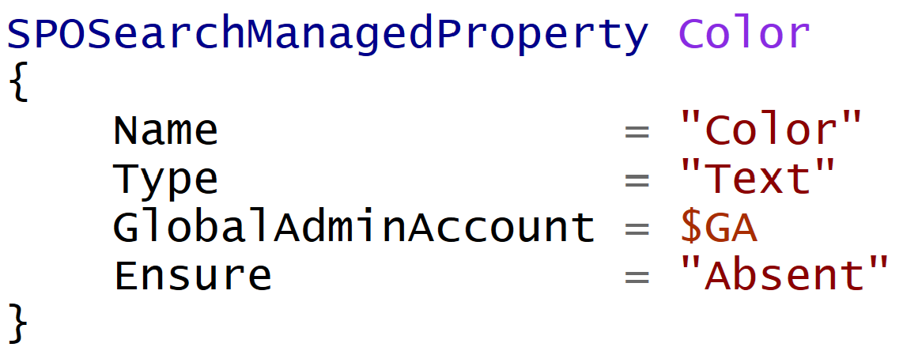
Ensure
DSC is not only about making sure that certain components are configured on a sever;
Most resources have a parameter Ensure exposed;
Setting Ensure = Absent makes sure that the specified component is NEVER configured on the server;
Hard to define all “non-config” scenarios….it’s actually impossible;
@NikCharlebois

Slide 12

DSC Modules
Macro components that extend the reach of DSC (e.g. SharePointDSC, SQLServerDSC, etc.)
All available on the PowerShell Gallery (http://PowerShellGallery.com)
@NikCharlebois

Slide 13
Demo 1
Basic DSC
@NikCharlebois

Slide 14

Office365DSC
@NikCharlebois

Slide 15




What does Office 365 DSC have to offer?
Manage your tenant’s configuration “as code”
Export your current
tenant configuration
Synchronize configuration on multiple tenants & Assert against Templates
Monitor and Alert on Configuration Drifts
@NikCharlebois

Slide 16


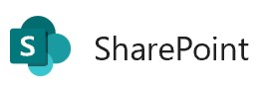
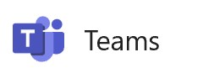


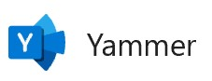
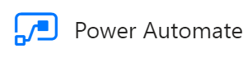


Office365DSC
Supported workloads:
Support coming:
Parallel initiative:
Security & Compliance
PowerApps
AzureADDSC
@NikCharlebois

Slide 17
Logic Flow
Abstraction layer sitting on top of all underlying modules;
Allows you to write 1 configuration to handle all workloads;
Office365DSC Configuration
SharePoint PnP
MicrosoftTeams
SkypeForBusinessAPI
Exchange Online Shell
…
Remote Calls
Security & Compliance
@NikCharlebois

Slide 18

Community
100% Open-Source on GitHub;
All the documentation is in the Wiki;
Worldwide team of dedicated engineers;
Looking for help:
Testing;
Development;
Suggestions, ideas, and feedback;
aka.ms/O365DSC
@NikCharlebois

Slide 19

Official Website
Upcoming Templates Repository;
Information on how to get started;
Office365DSC.com
@NikCharlebois

Slide 20
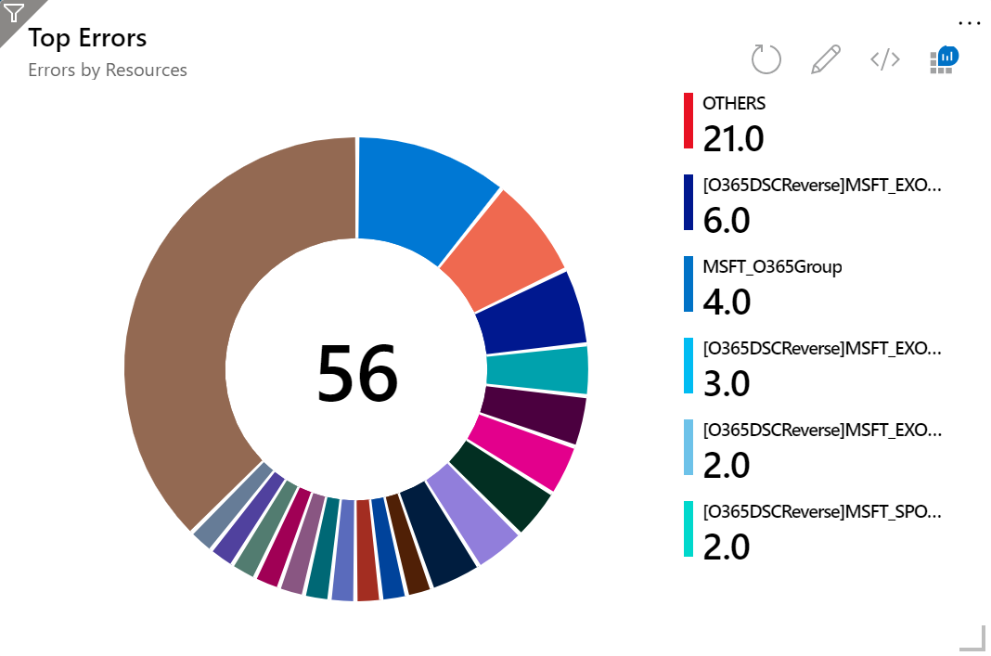
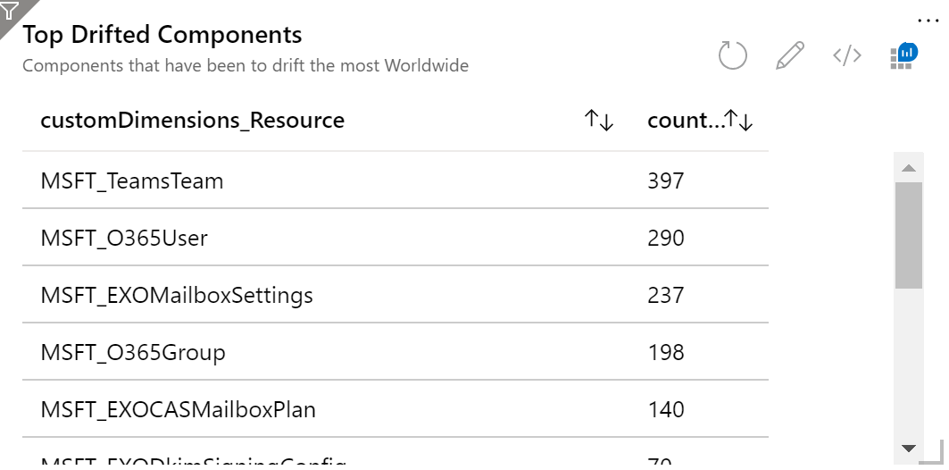
Telemetry
Allow Organizations to specify their own App Insights Key
Track drifts, configuration and extraction activities
@NikCharlebois

Slide 21
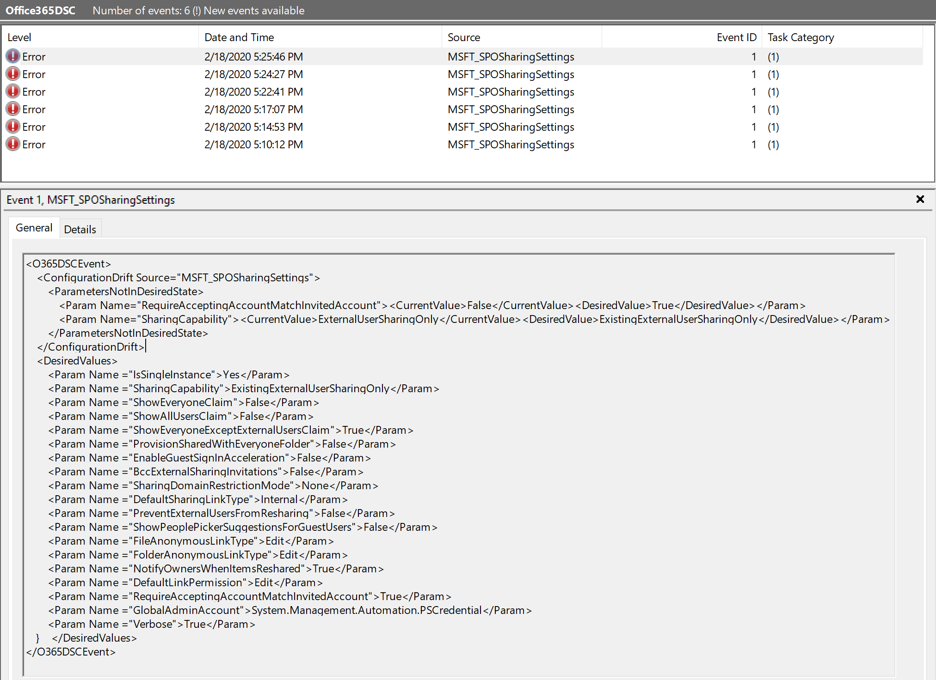
Advanced Logging
Isolated event log;
Extensive details about errors/drifts;
@NikCharlebois

Slide 22

Authentication
Fully support Multi-Factor Authentication (MFA) for Extraction;
MFA is not supported for applying and monitoring configurations;
Consistency checks (e.g. every 15 minutes) wouldn’t make sense;
Recommendation is to have different workload services accounts, without MFA;
@NikCharlebois

Slide 23
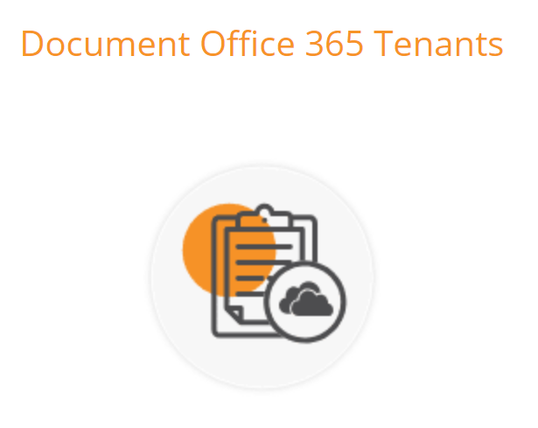

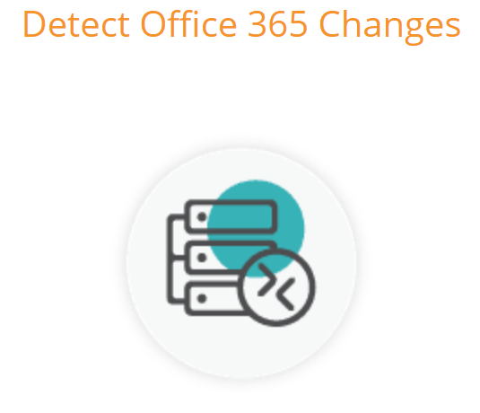
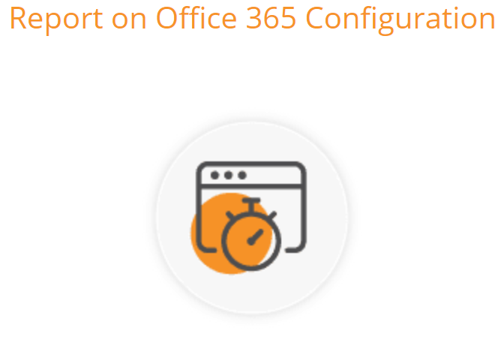

Partner – SysKit Trace
Partners Solutions

Slide 24
Demo 2
Office 365 Deployment
@NikCharlebois

Slide 25

ReverseDSC
@NikCharlebois

Slide 26
ReverseDSC
Extract DSC Configuration from existing environments;
Native feature inside of Office365DSC;
Installing Office365DSC exposes Export-O365Configuration;
Offers a RETRO User interface straight out of the 90’s for granular extractions
@NikCharlebois

Slide 27
ReverseDSC Scenarios
Recreating an environment for Troubleshooting;
Point-in-time snapshot;
Delta Analysis;
Disaster Recovery;
On-boarding existing environment onto DSC for monitoring;
Keeping environments in-sync;
@NikCharlebois

Slide 28
Demo 3
ReverseDSC for Office365DSC
@NikCharlebois

Slide 29
Demo 4
Tenants Synchronization
@NikCharlebois

Slide 30

Azure Automation
@NikCharlebois

Slide 31

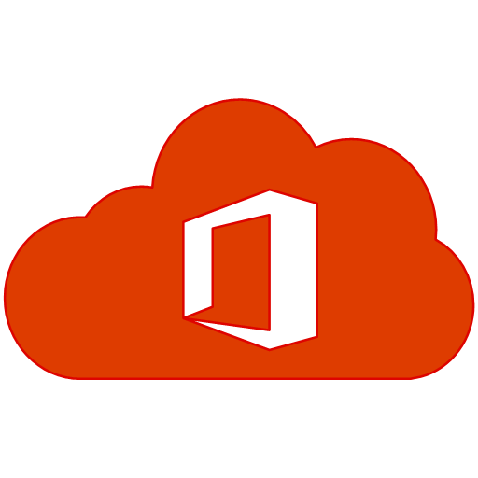
Dedicated Virtual Machine Agent
Requires a Virtual Machine to be up and running to deploy configuration and do consistency checks;
Config
Dedicated Virtual Machine
Tenant
@NikCharlebois

Slide 32
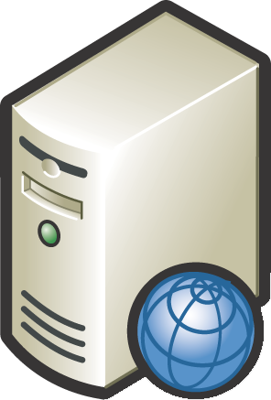

Pull Server
Central server that stores all configurations for your enterprise (e.g. WFE, SQLServer, DC, etc.)c
Pull Server
@NikCharlebois

Slide 33
Overview of AADSC
Pull Server as a Service;
Included as part of an Azure Automation Account;
Free when used with Azure VMs;
- You do pay for the VM;
@NikCharlebois

Slide 34


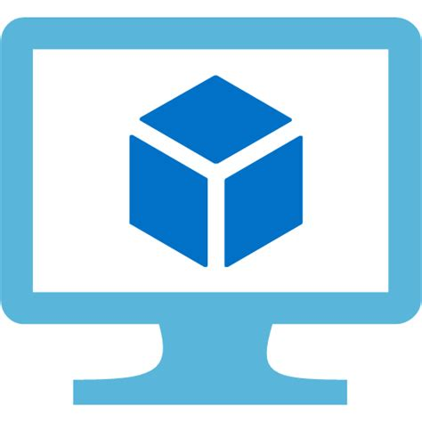
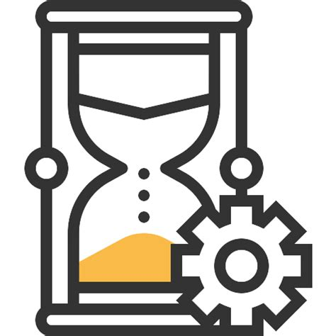
Overview of AADSC[…]
Azure Virtual Machine
DSC Script
Azure Automation
@NikCharlebois

Slide 35





Process – With Dedicated VM Agent
Triggers
Compiles
Uploads
Azure DevOPS Repo
Assigns
Commits Changes
Deploys
Master Config
Virtual Machine Agent
Office 365 Tenant
@NikCharlebois

Slide 36
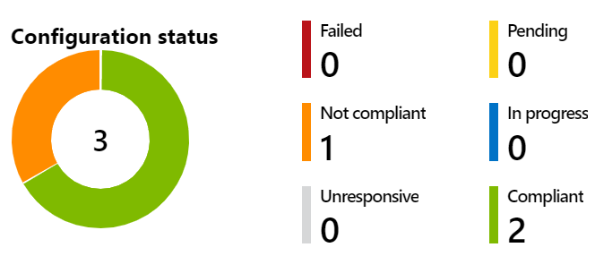
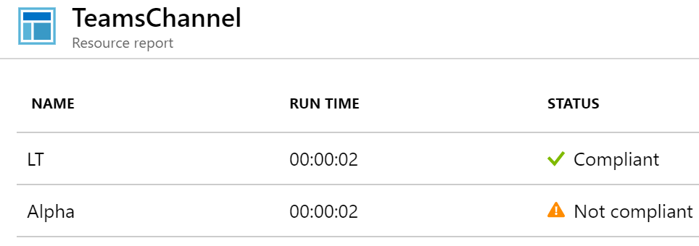
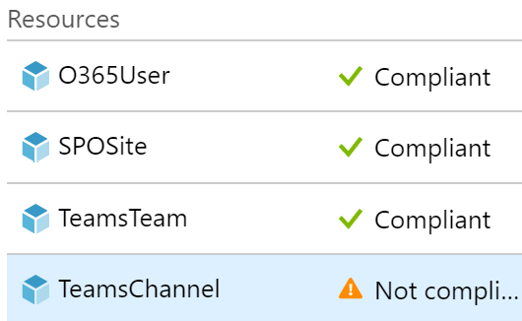
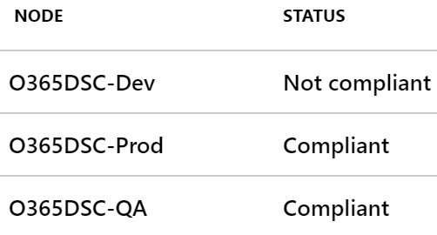
Azure Automation
Centrally manage configuration for all your tenants;
Get rich insights into potential configuration drifts;
@NikCharlebois

Slide 37

Azure DevOPS
@NikCharlebois

Slide 38

Azure DevOPS
Manage your Office 365 configuration as code;
Automate deployments upon configuration changes;
DevOPS at its best!
Challenge is to convince IT Pros to use it.
@NikCharlebois

Slide 39



“Agentless Process” with Pipelines
Changes Applied
Changes Applied
Azure DevOPS Repo
Dev Tenant
QA Tenant
Reviews & Approves
Commits Changes
Reviews & Approves
Master Config
Add/Modify/Delete
Dev Team
QA Team
@NikCharlebois

Slide 40


Monitoring Process
Compliant
Test-DSCConfiguration
Dev Tenant
Test-DSCConfiguration
Not Compliant
[SPOSite]abc
not compliant
QA Tenant
Test-DSCConfiguration
Compliant
Prod Tenant
@NikCharlebois

Slide 41
Demo 5
Azure DevOPS for Office 365
@NikCharlebois

Slide 42
Roadmap
@NikCharlebois

Slide 43
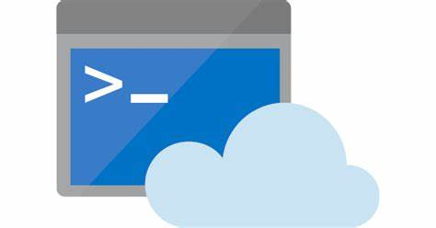
PowerShell Core & Cloud Shell
Reduce dependency footprint and leverage the Graph SDK;
Compatibility with PowerShell Core;
Exploring with PowerShell PG the concept of a DSC engine as a Service (LCM-as-a-Service);

Slide 44

ChatOPS
@NikCharlebois

Slide 45

Scenario #1
Reactive

Slide 46



John Smith [10:03 AM]
Hey Nik, has anything changed on the Production tenant by any chance?
Users have reported that they can no longer generate external URLs to share content in SharePoint.
Hey John, not sure, let me check…
!Bot Status
O365DSC Bot [10:04 AM]
Let me analyze your tenant…

Slide 47

John Smith [10:03 AM]
Hey Nik, has anything changed on the Production tenant by any chance?
Hey Nik, has anything changed on the Production tenant by any chance?
Users have reported that they can no longer generate external URLs to share content in SharePoint.
Hey John, not sure, let me check…
!Bot Status
O365DSC Bot [10:04 AM]
Let me analyze your tenant…
Yeah dude, it’s not in its Desired State

Slide 48
Users have reported that they can no longer generate external URLs to share content in SharePoint.
John Smith [10:03 AM]
Hey Nik, has anything changed on the Production tenant by any chance?
Hey Nik, has anything changed on the Production tenant by any chance?
Hey John, not sure, let me check…
!Bot Status
O365DSC Bot [10:04 AM]
Let me analyze your tenant…
Yeah dude, it’s not in its Desired State
SPOSharingSettings:
AllowExternalSharingSettings
Should Be | But was
$True | $False
I know how to fix this. Simply say: !Bot Autocorrect

Slide 49

!Bot Status
O365DSC Bot [10:04 AM]
Let me analyze your tenant…
Users have reported that they can no longer generate external URLs to share content in SharePoint.
John Smith [10:03 AM]
Hey Nik, has anything changed on the Production tenant by any chance?
Hey Nik, has anything changed on the Production tenant by any chance?
Hey John, not sure, let me check…
Yeah dude, it’s not in its Desired State
AllowExternalSharingSettings
Should Be | But was
$True | $False
SPOSharingSettings:
I know how to fix this. Simply say: !Bot Autocorrect
Oups. !Bot Autocorrect
O365DSC Bot [10:06 AM]
Let me work my magic!

Slide 50
!Bot Status
O365DSC Bot [10:04 AM]
Let me analyze your tenant…
Users have reported that they can no longer generate external URLs to share content in SharePoint.
Yeah dude, it’s not in its Desired State
John Smith [10:03 AM]
For setting SPOSharingSettings:
AllowExternalSharingUrl should be $True but is set to $False
Hey Nik, has anything changed on the Production tenant by any chance?
Hey Nik, has anything changed on the Production tenant by any chance?
Hey John, not sure, let me check…
I know how to fix this. Simply say: !Bot Autocorrect
Oups. !Bot Autocorrect
O365DSC Bot [10:06 AM]
Let me work my magic!
Ok, it’s fixed!
@John it should be fixed now, can you please confirm with the users? Thanks

Slide 51
Scenario #2
Pro-Active

Slide 52

O365DSC Bot [11:06 AM]
Configuration Drift detected in QA!
At 11:06 AM, the following issue was detected in the QA tenant
EXOOrganizationConfig:
AuditDisabled
Should Be | But was
$False | $True
O365DSC Bot
Configuration Drift detected in QA

Slide 53
Scenario #3
Report & Query

Slide 54
!Bot Report –Prod Teams
O365DSC Bot [1:43 PM]
Analyzing the current state of the Teams workload on Prod tenant
TeamsTeams (1/14)
DisplayName | IP Forum: Digital Workplace
Description | Discussions around the DW IP
GroupID | {34256-72435-18354-24682-20154}
MailNickName | IPForumDW
AllowGiphy | $True
AllowStickersAndMemes | $False

Slide 55
Additional Resources
Official Website:
http://Office365DSC.com
YouTube channel:
aka.ms/O365DSCVideos
Microsoft Virtual Academy session on DSC and ReverseDSC
https://channel9.msdn.com/Series/SharePoint-Automation-with-DSC
Nik Charlebois’ Blog
https://NikCharlebois.com
@NikCharlebois

Slide 56
Thank You!

